Slide 1
The Need for PFM
CFS
2
Second Edition
Updated July 2025

Slide 2



Topics
1.
2.
3.
Financial Problems and Concerns
Military Risk Factors
Policies

Slide 3


Benefits of a Financial Plan
Freedom from financial stress and worry
Wealth building
Enable choices

Slide 4
Financial Problems and
Concerns
Presenting Financial Concerns
Real Reasons
Emotional Fallout
Implications
SM
2-2 to
2-3

Slide 5

Financial Risk Factors for
Military Members
Age
Lifestyle
Easy Credit
SM
2-4

Slide 6
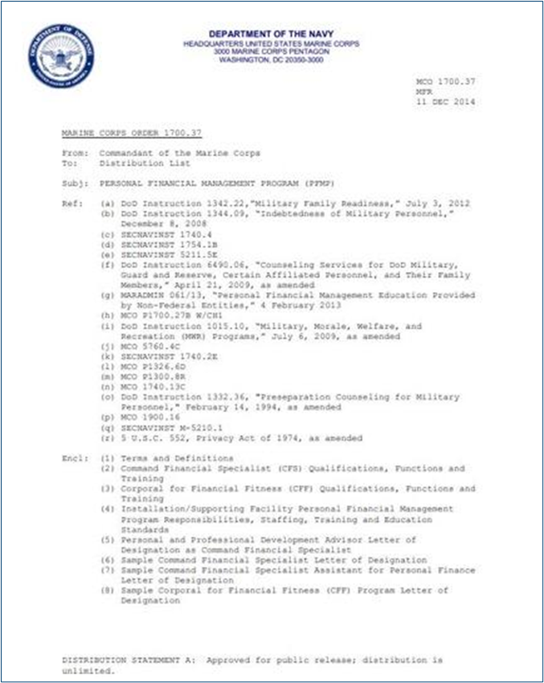
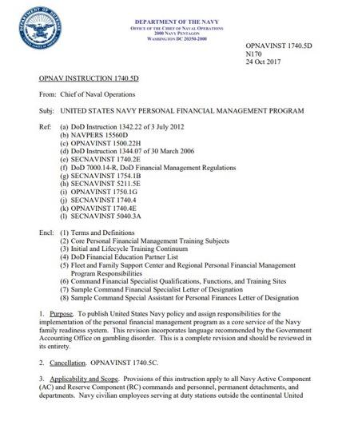
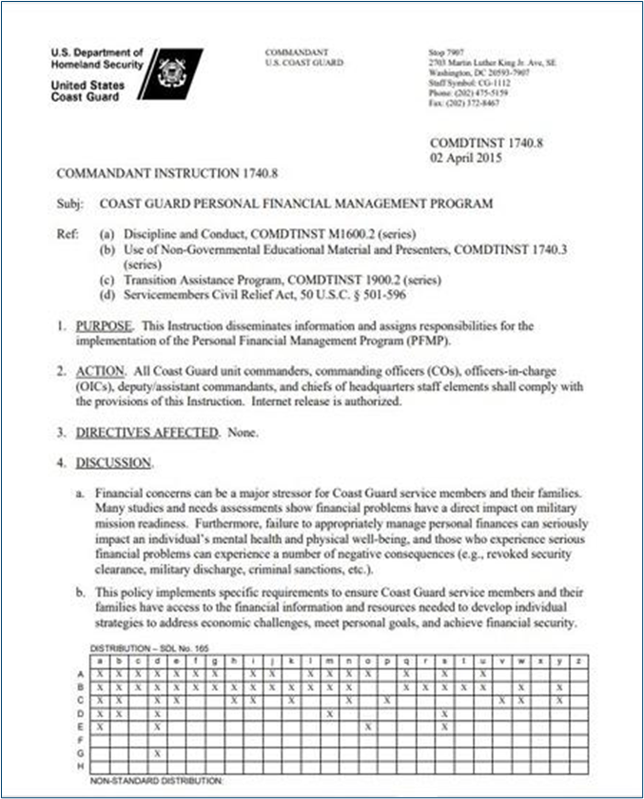
Service-specific PFM
Program Policies
USN – OPNAVINST 1740.5 (series)
USMC – MCO 1700.37
USCG – COMDTINST 1740.8 (series)

Slide 7
CFS Roles & Responsibilities
Components of PFM Program by Military Branch
 | NAVY | MARINE CORPS | COAST GUARD
Education and Training | ✓ | ✓ | ✓
Information and Referral | ✓ | ✓ | ✓
Financial Counseling | ✓ | ✓ | ✓
Consumer Advocacy | ✓
CFS Program |  |  | ✓
Outreach |  |  | ✓
Collaboration and Coordinating |  |  | ✓
CG SUPRT Financial Wellness Program |  |  | ✓
SM
2-5

Slide 8
CFS Roles & Responsibilities (continued)
Responsibilities of a CFS by Military Branch
 | NAVY | MARINE CORPS | COAST GUARD
Education and Training | ✓ | ✓ | ✓
Information and Referral | ✓ | ✓ | ✓
Financial Counseling | ✓
Basic Budgeting |  |  | ✓
Consumer Advocacy | ✓
SM
2-5

Slide 9
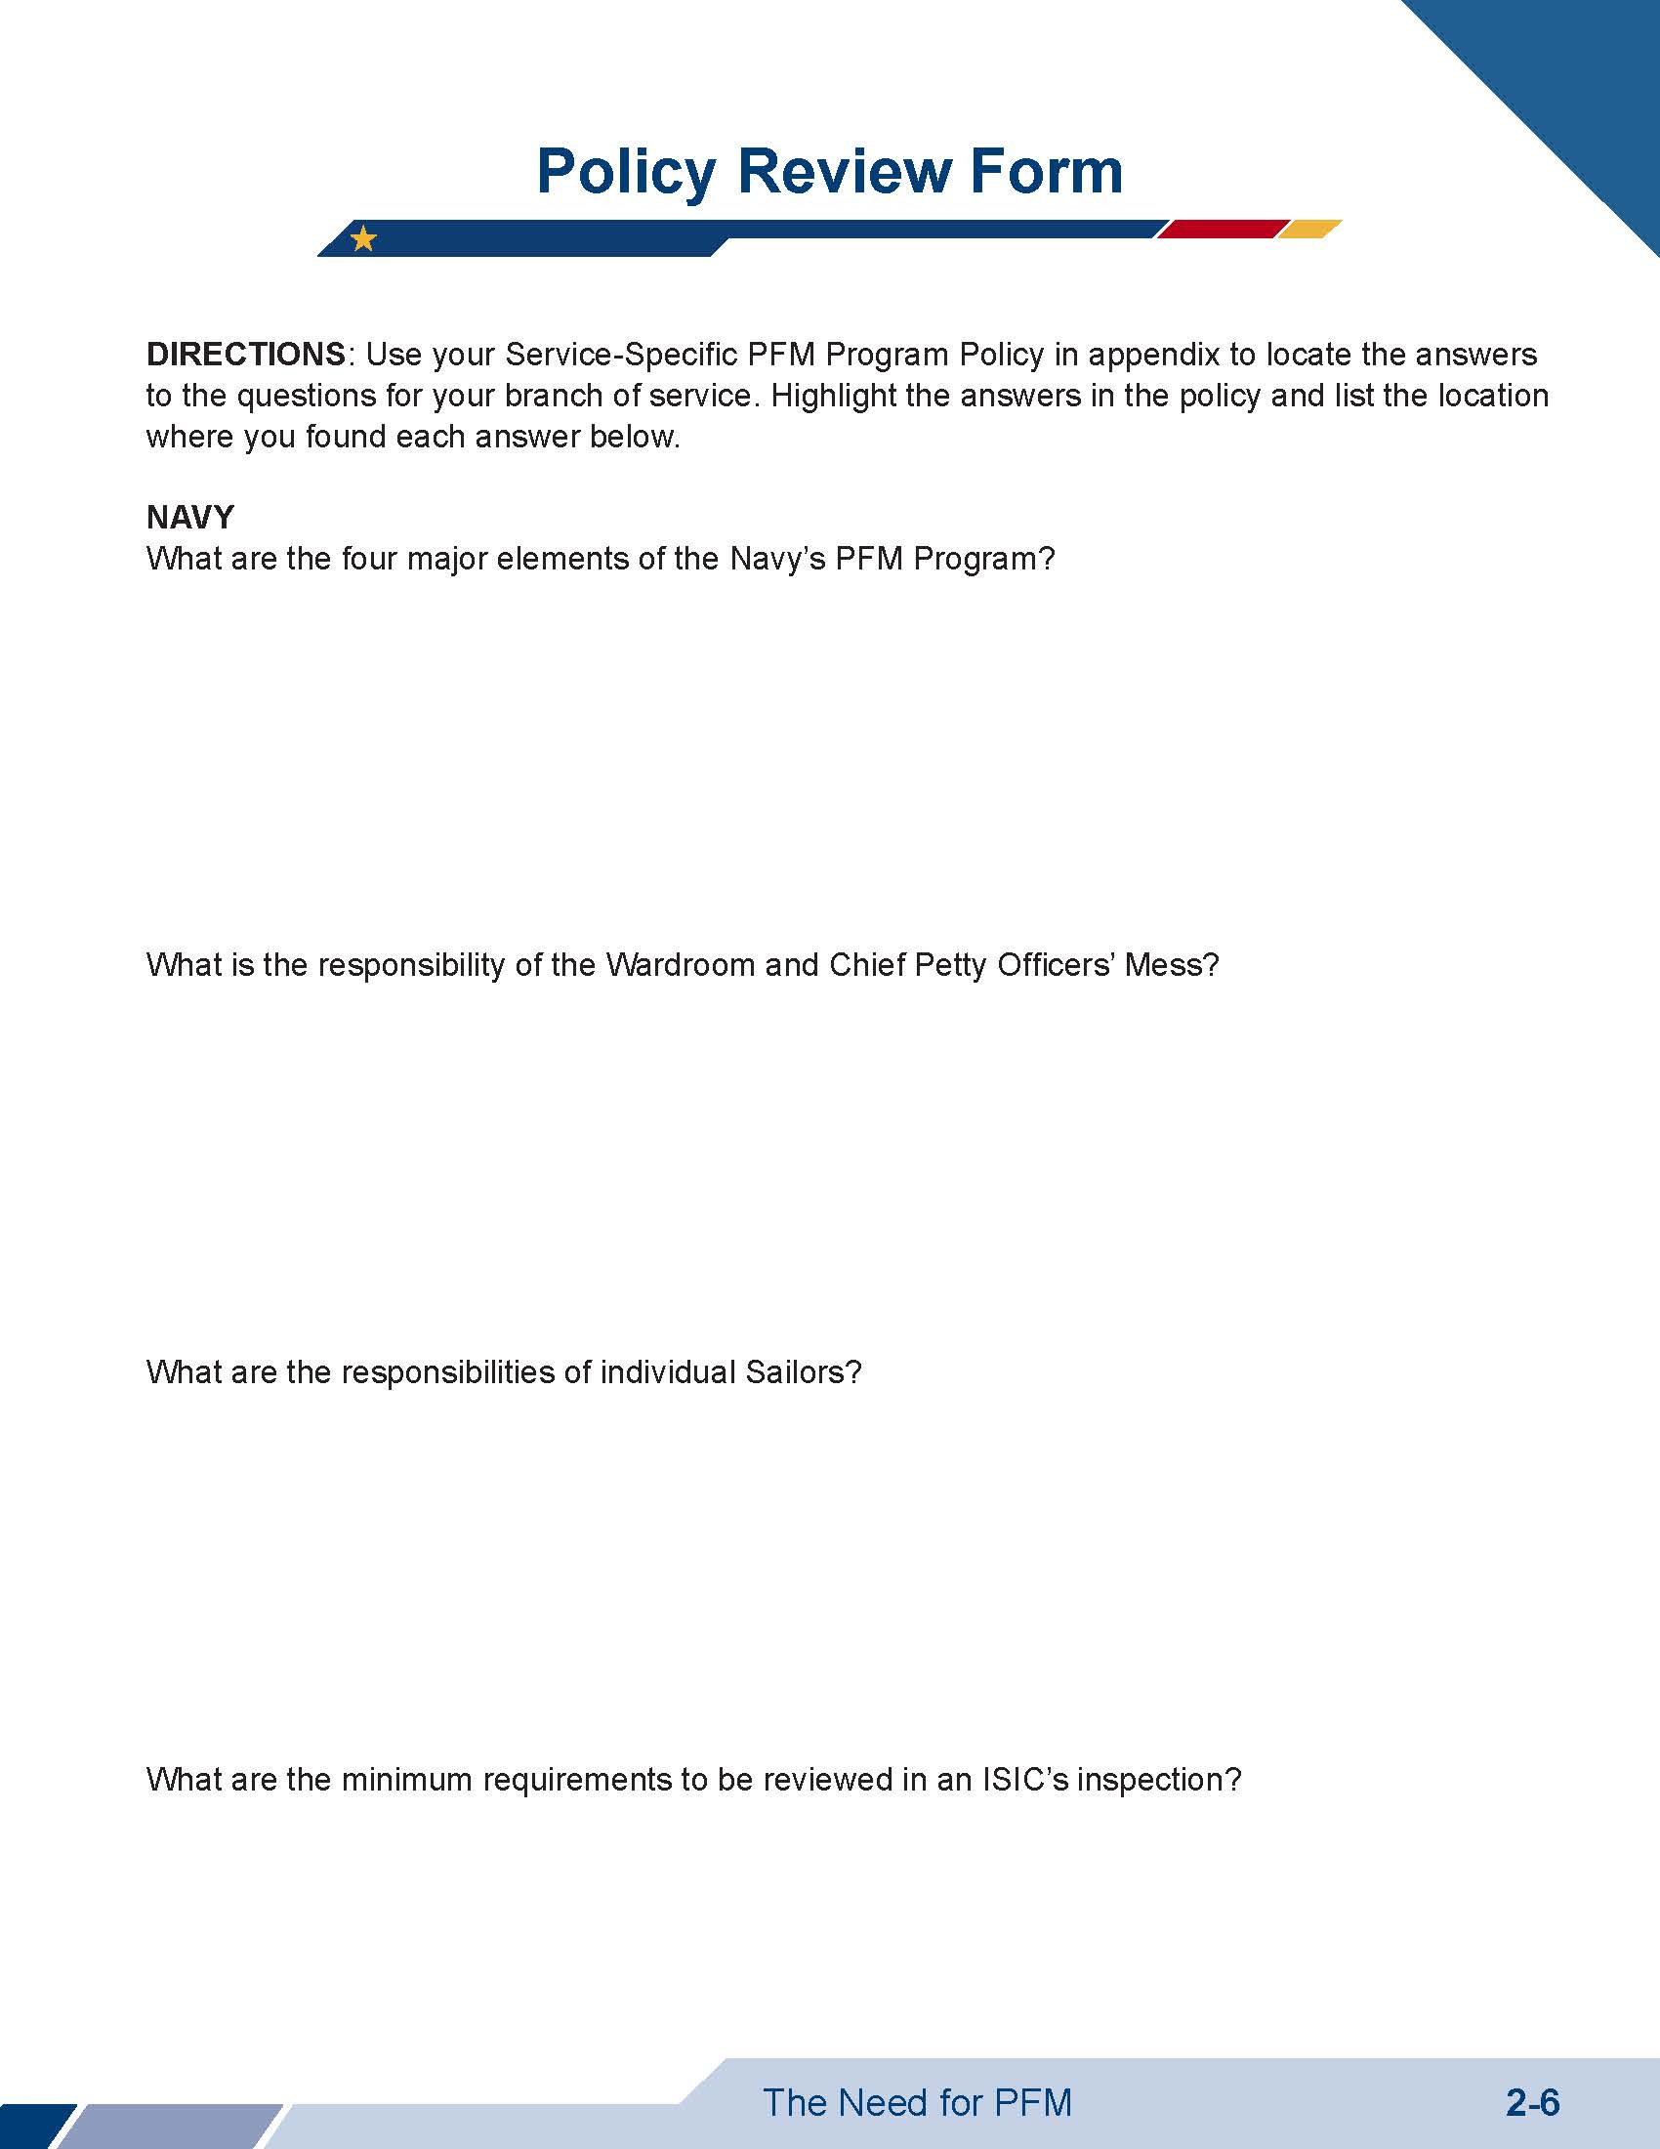
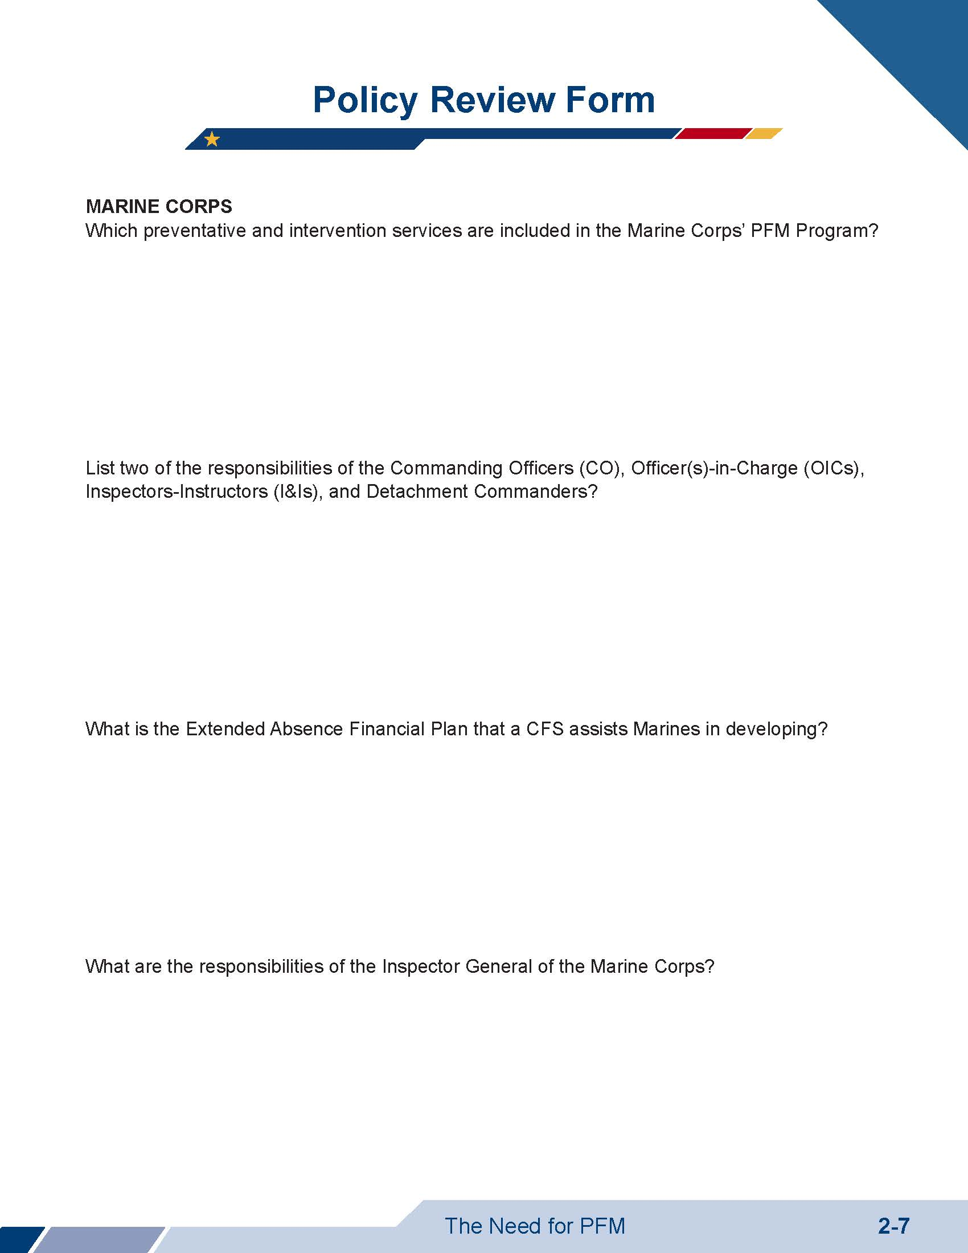

Activity: Policy Review
SM
2-6 to
2-8

Slide 10
Questions?
The appearance of U.S. Department of Defense (DoD) or U.S. Department of Homeland Security (DHS) visual information does not imply or constitute DoD or DHS endorsement.

